Slide 1

Automated Terrain Classification Using Deep Learning
This presentation explores the development of an automated system for classifying terrain images using deep learning techniques, particularly convolutional neural networks (CNNs). We'll delve into the process from data collection to model deployment, highlighting the benefits and challenges of this approach.

Slide 2
Problem Statement
Terrain Classification Challenges
The Need for Automation
Accurate terrain classification is essential for various applications, including environmental monitoring, agricultural planning, and geological surveys. Traditional methods often rely on manual inspection, which is time-consuming and prone to errors. This project aims to address these challenges by developing an automated terrain classification system.
The need for a reliable and efficient system to classify terrain images is growing. With the availability of large datasets and advances in deep learning algorithms, automation becomes a viable and effective solution.

Slide 3
Project Planning
1
Data Collection and Preparation
Download and extract the terrain image dataset. Preprocess the images (resizing, normalization). Split the dataset into training and validation sets.
2
Model Building
Define the architecture of the CNN model. Compile the model with appropriate loss functions and optimizers.
3
Model Training
Train the model on the training dataset. Monitor the training process and adjust hyperparameters as needed.
4
Model Evaluation
Evaluate the model's performance on the validation dataset. Calculate and report evaluation metrics (accuracy, precision, recall, F1-score). Identify Overfitting or Underfitting: Compare the model's performance on the training and validation datasets with the help of graphs.
5
Model Testing
Once a project is finished, it’s essential to evaluate its success. This involves a verification process, often called testing. For instance, in software development, specific test cases are designed and executed to check if the software functions as intended and meets the desired outcomes
.

Slide 4
Data Collection and Preparation
1
Dataset Acquisition
2
Data Preprocessing
3
Data Splitting
The first step involves acquiring a dataset of terrain images. This can be sourced from public repositories, satellite imagery, or collected directly. The dataset should include diverse terrain types to ensure the model learns to distinguish between different categories.
Once acquired, the images need to be preprocessed. This involves resizing images to a uniform size, normalizing pixel values to a specific range, and converting them to a suitable format for the CNN model. Preprocessing enhances the training process and improves model performance.
The dataset is then split into training and validation sets. The training set is used to train the model, while the validation set is used to evaluate its performance and prevent overfitting.

Slide 5



Model Building
Convolutional Neural Networks (CNNs)
Convolutional neural networks are the backbone of this project, chosen for their ability to extract spatial features from images. CNNs consist of layers that perform convolutions, pooling, and fully connected operations to learn patterns and identify features in images.
1
LeakyRelu
ReLU (Rectified Linear Unit) and Leaky ReLU are popular activation functions used in deep learning models, especially for convolutional neural networks. ReLU introduces non-linearity by setting all negative inputs to zero, thereby helping models learn complex patterns. However, a drawback of ReLU is the "dying ReLU" problem, where neurons can become inactive and stop learning during training if they constantly output zero due to negative inputs. Leaky ReLU addresses this issue by allowing a small, non-zero gradient for negative inputs
2
Model Compilation
Once the architecture is defined, the model is compiled. This step involves defining the loss function, optimizer, and evaluation metrics. The loss function measures the model's error, the optimizer adjusts the model's parameters to minimize this error, and the evaluation metrics assess the model's performance.
3

Slide 6
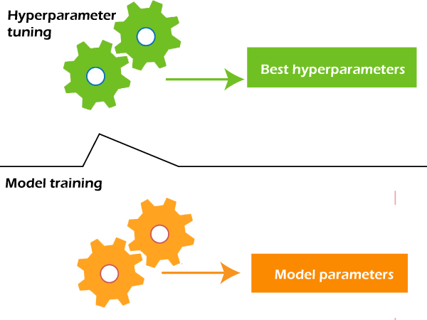
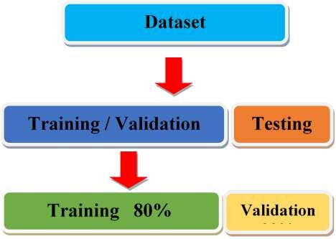
Model Training

Slide 7
Model Training
Training Process
1
The trained model is fed the training dataset, and the model learns to associate specific features with different terrain types. The training process involves iteratively adjusting the model's parameters to minimize the loss function.
Hyperparameter Tuning
Hyperparameter tuning is crucial for achieving optimal performance. These are parameters that define the model's structure and training process, such as learning rate, batch size, and number of epochs. Careful tuning can significantly impact the model's accuracy and generalization.
2
Overfitting and Underfitting
Overfitting occurs when the model learns the training data too well and performs poorly on unseen data. Underfitting occurs when the model is too simple and unable to learn the complex patterns in the data. Monitoring training and validation performance helps identify these issues and apply appropriate techniques to address them.
3

Slide 8
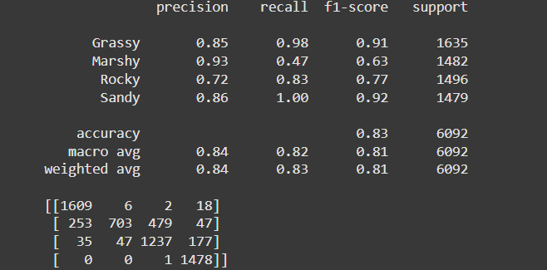
Model Evaluation
1
2
3
Validation Dataset
Evaluation Metrics
Identifying Overfitting
The trained model is evaluated on the validation dataset, which it has not seen during training. This assessment provides a realistic measure of the model's ability to generalize to unseen data.
Several metrics are used to evaluate the model's performance, including accuracy, precision, recall, and F1-score. These metrics provide insights into the model's ability to correctly classify different terrain types and its overall effectiveness.
If the model performs significantly better on the training set than the validation set, it indicates overfitting. This issue can be addressed by techniques such as regularization, dropout, or early stopping.
Classification report

Slide 9
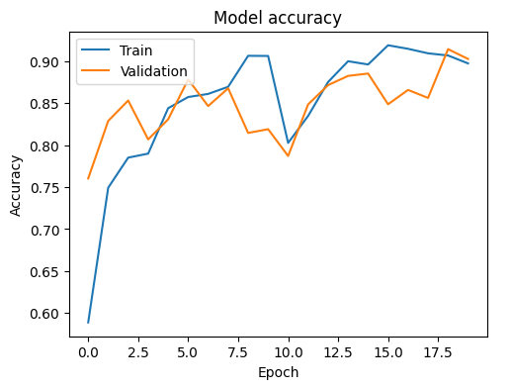
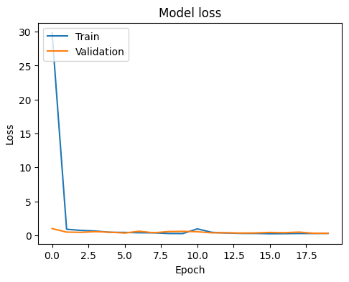
Model Accuracy Graph
Observation:The training accuracy steadily increases, approaching 90% or higher by the end of training. The validation accuracy fluctuates but generally tracks the training accuracy, indicating that the model is learning effectively and not overfitting significantly.
Model Loss Graph
Observation: Training loss decreases rapidly within the first few epochs and stabilizes at a low value. Validation loss remains relatively stable and follows the same pattern as training loss, indicating consistency between training and validation.

Slide 10




Testing and Verification
Test Case Design
Test cases are designed to thoroughly evaluate the model's functionality. These cases include different terrain types, challenging images, and edge cases to ensure the model performs as expected.
Performance Comparison
The model's performance is compared against established benchmarks or existing methods to determine its relative effectiveness and identify areas for improvement.
Bug Detection and Resolution
Testing helps identify any bugs or unexpected behaviors in the model. These issues are addressed through debugging and code modifications to improve the model's reliability.

Slide 11



Future Scope: Expanding the Project
Web Application
1
Development of a user-friendly web application will enable wider accessibility to the trained model.
Real-Time Classification
2
Users can upload terrain images and receive instant classification results.
Cloud Deployment
3
Deploying on platforms like AWS or Google Cloud will ensure scalability and accessibility.

Slide 12


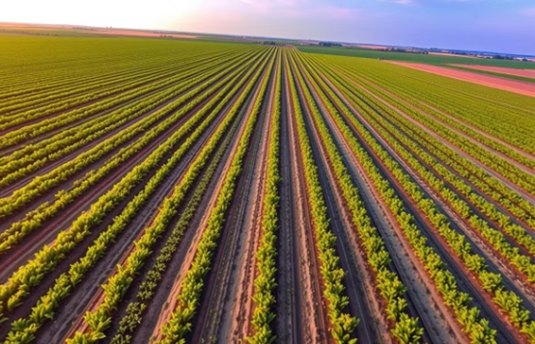
Conclusion
This project successfully demonstrated the application of Convolutional Neural Networks (CNNs) for terrain image classification, categorizing landscape images into predefined classes. Key stages included data preprocessing, model training, evaluation, and prediction. By adhering to best practices in design, coding, and testing, the system achieved high validation accuracy, ensuring reliability and quality. The use of TensorFlow and Keras provided a robust framework for building and training the model, showcasing the potential of deep learning for complex image classification tasks. The developed system offers valuable applications in geological surveys, agriculture, and environmental monitoring, significantly enhancing efficiency and accuracy in these domains.

Slide 13


Individual Contribution
Surya Prakash
Data Collection and Preprocessing
JPS Saahil
Model Building
Shashank Dewangan
Model Training
Jatin Pathak
Model Evaluation
Varun Mishra
Testing and Verification
Aditya Pandey
Documentation and Reporting

